Slide 1
Gut-brain connections: What happens after TBI?
Dr Josephine Braid Fafrm (racp) afmcp
Rehabilitation physician, orange nsw

Slide 2
Gut-brain connections
Enteric nervous system
Who lives there
Communication with the brain
Intestinal permeability
Implication in neurological diseases
Traumatic brain injury and changes in the brain gut axis

Slide 3
Enteric Nervous Systems
The enteric nervous system (ENS) is the largest component of the autonomic nervous system and is uniquely equipped with intrinsic microcircuits that enable it to orchestrate gastrointestinal function independently of central nervous system (CNS) input.

Slide 4
Who and what is in the gut
Microbiota in the gut weigh 1-2kg (similar to weight of adult human brain)
Microbiome consists of genetic material of bacteria, viruses, fungi, archae inhabiting the gut. Estimated 100 trillion organisms. Co-exists with gut pathogens.
Regulates the immune and endocrine system. Stress and sleep deprivation are known to increase cortisol which causes overgrowth of bad bacteria. 1
70% serotonin produced in the gut by the microbiome (Candida, Streptococcus, Escherichia, Enterococcus)
GABA, Dopamine, Acetylcholine and Noradrenaline are all made by gut bacteria
1. Dinan et al. Psychoneuroendocrinology 2012

Slide 5
The gut microbiome
The gut microbiome serves numerous functions in the human body and is so crucial to our survival that it has been dubbed “our forgotten organ.”
Some of the roles it serves include:
  digestion of polysaccharides,
  development of the immune system,
  defence against infections,
  regulation of angiogenesis, and
  production of essential proteins that our genes do not encode
D’Argenio, V.; Salvatore, F. The role of the gut microbiome in the healthy adult status. Clin. Chim. Acta 2015, 451, 97–102.

Slide 6
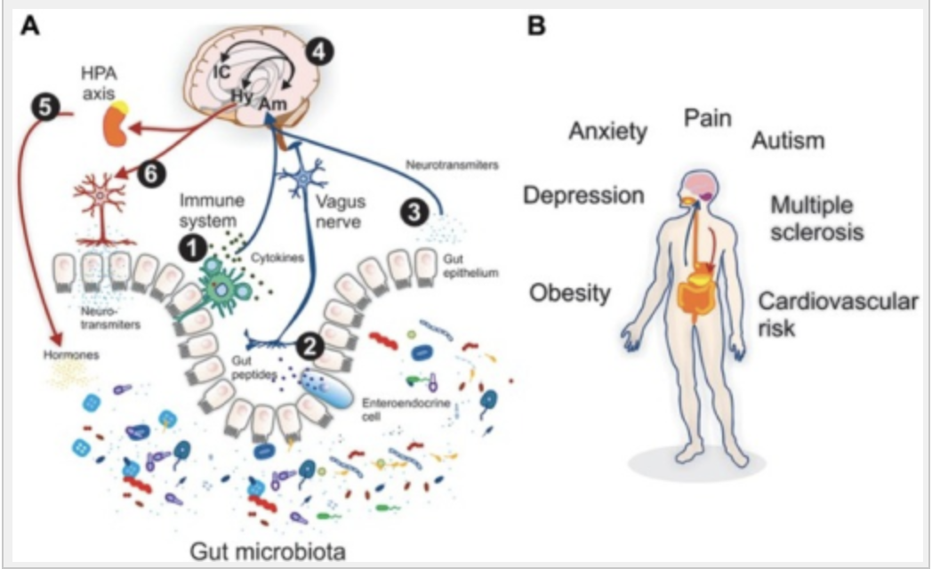
Bidirectional gut brain flow (efferent, afferent)
The microbiota-gut-brain axis: neurobehavioral correlates, health and sociality.
Montiel-Castro AJ, et al. Front Integr Neurosci (2013)

Slide 7
Intestinal Permeability (leaky gut)
Gut injury: Gluten, Glyphosate (RoundUp), Lipopolysaccharides, medications (antibiotics, NSAIDs), stress
Zonulin released, tight junctions open
Systemic release of zonulin opens multiple tight junctions:
  Gut
  Blood brain barrier
  Vascular system
  Kidney tubules

Slide 8
Consequences of intestinal permeability
Diseases associated with Tight Junction Permeability:
Type 1 Diabetes
Multiple Sclerosis
Rheumatoid arthritis
Can also be associated with development of:
Cancer
Allergies
Infections
Fasano A Zonulin and Its Regulation of Intestinal Barrier Function: The Biological Door to Inflammation, Autoimmunity, and Cancer Physiology 2011;91:151-175

Slide 9
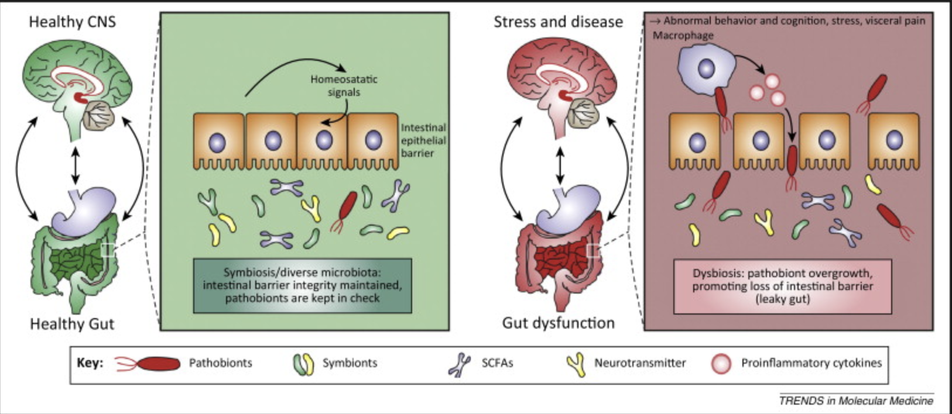
Microbiota and neurodevelopmental windows: implications for brain disorders.Borre YE et al Trends in Mol Med 2014:20;509-518

Slide 10
Brain-Gut axis and neurologic injury
The brain-gut axis (BGA), also referred to as the gut-brain axis, is a communication network that links together the CNS and the enteric nervous system (ENS) [1]. This axis functions in a bidirectional manner; thus, each component of the network can influence the other.
The downstream communication from the brain to the gut involves vagal pathways that innervate the ENS, which is critical for the function of the GI tract [2].
From a gut-to-brain viewpoint, numerous factors such as gut lipopolysaccharides, cytokines, neuropeptides, and protein messengers connect the gastrointestinal tract to the brain [2].
1. Leaphart, C.L.; Tepas, J.J., III. The gut is a motor of organ system dysfunction. Surgery 2007, 141, 563–569.
2. Shanahan, F. Brain-gut axis and mucosal immunity: A perspective on mucosal psychoneuroimmunology. Semin. Gastrointest. Dis. 1999, 10, 8–13.

Slide 11
Gut influences brain in many ways
The gut microbiome can affect the brain via one of many different pathways:
  the neuroanatomical pathway of the gut-brain axis,
  the neuroendocrine–hypothalamic–pituitary–adrenal axis,
  the gut immune system,
  the gut microbiota metabolism system, and
  the intestinal mucosal barrier and the blood brain barrier
Wang, H.X.; Wang, Y.P. Gut Microbiota-brain Axis. Chin. Med. J. 2016, 129, 2373–2380.

Slide 12
Disturbances of Brain Gut Axis
Disturbances of the BGA are implicated in many neurologic disease processes. Furthermore, the relatively recent discovery of the significance of the gut microbiota to the brain-gut axis has led to the re-evaluation of CNS diseases [1].
The gut microbiota likely plays a role in a wide range of neurological conditions, including autism spectrum disorder, anxiety, depression, chronic pain, stress, Alzheimer’s disease, and Parkinson’s disease [2]. In fact, intestinal inflammation and pathology in Parkinson’s disease precedes pathologic changes observed in the CNS by decades
1. Mayer, E.A et al. Gut microbes and the brain: Paradigm shift in neuroscience. J. Neurosci. 2014, 34, 15490–15496.
2. Houser, M.C et al. The gut-brain axis: Is intestinal inflammation a silent driver of Parkinson’s disease pathogenesis? NPJ Parkinsons Dis. 2017, 3, 3.

Slide 13
TBI and changes in the gut
Changes seen in the gut as soon as 4 mins post injury
Brain trauma can make colon more permeable. Potential for harmful microbes to migrate from intestine throughout body causing infection.
Post TBI, people are 12x more likely to die from septicaemia and 2.5x more likely to die from digestive system issue, c/w those without TBI.
In mouse model, researched how gut dysfunction may worsen brain inflammation after TBI. Mice with E.coli rodent equivalent infection had worse brain inflammation than those not infected. Increased hippocampal nerve loss than in mice without infection. Importance of bidirectional gut brain communication and long term effects of TBI.
Ma E L et al. Bidirectional brain-gut interactions and chronic pathological changes after tbi in mice. Brain Behaviour and Immunity 2017;66:56.

Slide 14
Potential Therapeutic Interventions
Investigation into the BGA in the setting of systemic injury and TBI has identified several promising targets for intervention.
One possible treatment involves mitigating the gut dysbiosis that results from TBI by attempting to restore the normal gut microbiota.
Faecal microbiota transplant (FMT) is one method of addressing this problem. FMT has been used to successfully treat several conditions including Clostridium difficile infection, irritable bowel syndrome, Crohn’s disease, and ulcerative colitis
Borody, T et al. Faecal microbiota transplantation in gastrointestinal disease: 2015 update and the road ahead. Expert Rev. Gastroenterol. Hepatol. 2015, 9, 1379–1391

Slide 15
Nutrition post TBI
In addition, in 2011, the Institute of Medicine recommended that patients with TBI should be given a high level of nutrition for two weeks to curtail inflammation [1].
Dietary treatments in the form of early enteral nutrition and intake of glutamine, arginine, nucleotides, and omega-3 fatty acids are another potential therapy that stimulates immune cells and promotes gut barrier health [2]. Vitamins and minerals such as nicotinamide, zinc, and magnesium have also shown potential in pre-clinical models
1. Institute of Medicine. Nutrition and Traumatic Brain Injury: Improving Acute and Subacute Health Outcomes in Military Personnel; Erdman, J., Oria, M., Pillsbury, L., Eds.; The National Academies Press: Washington, DC, USA, 2011.
2. Todd,S.R.;Gonzalez,E.A.;Turner,K.;Kozar,R.A.Updateonpostinjurynutrition.Curr.Opin.Crit.Care 2008, 14, 690–695.

Slide 16
Conclusion
Through disruption of the brain gut axis and the intimate involvement of the GI microbiota, TBI may initiate a feedback loop that potentiates a neuroinflammatory cascade and leads to secondary brain injury. TBI-induced dysbiosis, through its impact on the BGA, may potentiate secondary injury and influence functional outcome.
There is limited clinical data specifically regarding the effects of TBI on the microbiome and how the microbiome may then feed into that axis and further affect outcome.
Further research into the gut microbiome in the setting of TBI holds the exciting potential to influence treatment of brain-injured patients and enhance quality-of-life for patients with TBI.

Slide 17
Thank you
Contact details:
  info@braidhealth.com.au
  www.braidhealth.com.au
  02 5310 6061

